Slide 1
EMS system review and blueprint report Presented by Doug Wolfberg Page, Wolfberg & Wirth, LLC
Solano EMS Cooperative
2020-2030 EMS RFP Process

Slide 2
Overview
Project Summary and Timeline
EMS System Review
Revenues, Costs and Oversight
EMS System Blueprint
Our recommendations for 2020-2030

Slide 3
Project Summary
Phase I – EMS System Review July – Sept 2018
Data and documentation review 6 meetings total
Stakeholder engagement process
Phase II – Draft RFP Oct ‘18 – Feb ‘19
SEMSC and stakeholder review
Submission to EMSA
Phase III – Proposal Review, Mar – Sept 2019 Scoring and Contractor Selection

Slide 4
Proposed* Key Dates *Not official
SEMSC Special Meeting – RFP Approval – Dec 2018
IRP Framework to SEMSC Board – January 2019
Projected Release of RFP – January 2019
Mandatory Pre-Bid Conference and RFP Addenda – March 2019
Proposals Due – June 2019
Notice of Contract Award – August 2019
Contract Signed – September 2019
Commencement of Contract – May 2020

Slide 5
Project Methodology
Document and Data Review
PWW made extensive requests for information from SEMSC and Contractor staff
Stakeholder Listening Sessions
6 sessions held between July – September
Two open forums and four focus groups
Literature Search and Review
To allow EMS system design to reflect evidence-based and national consensus-based best practices

Slide 6
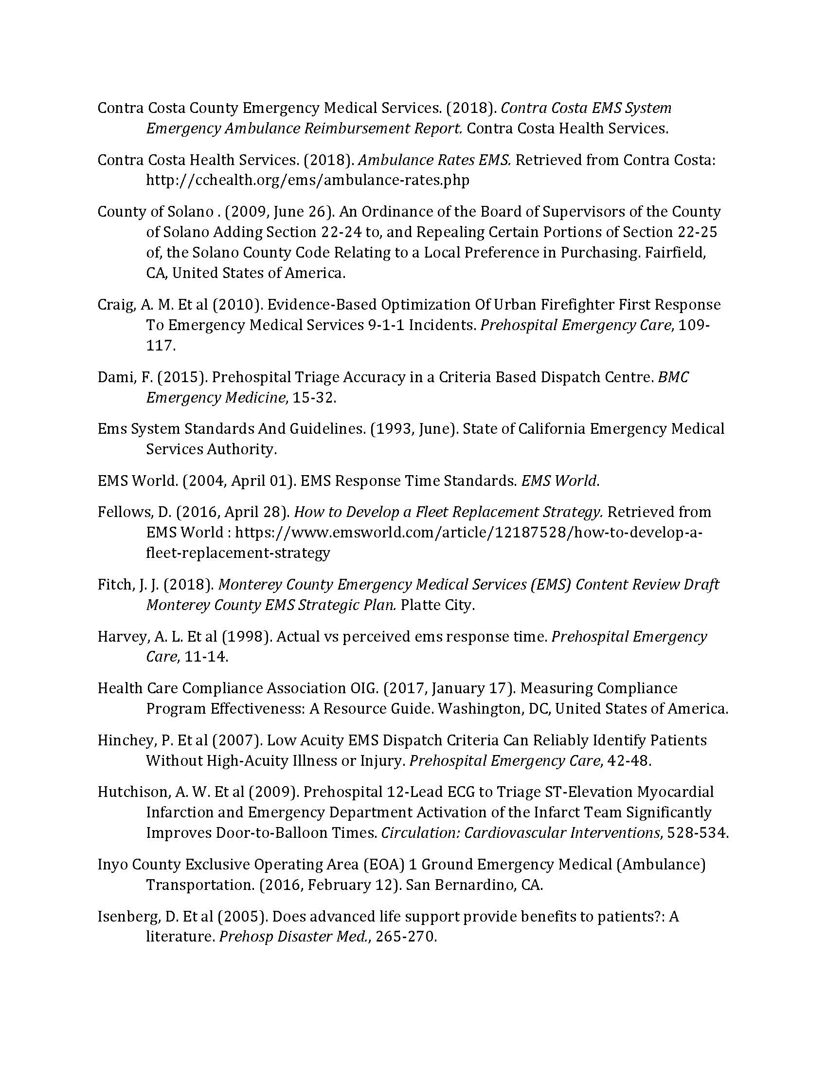
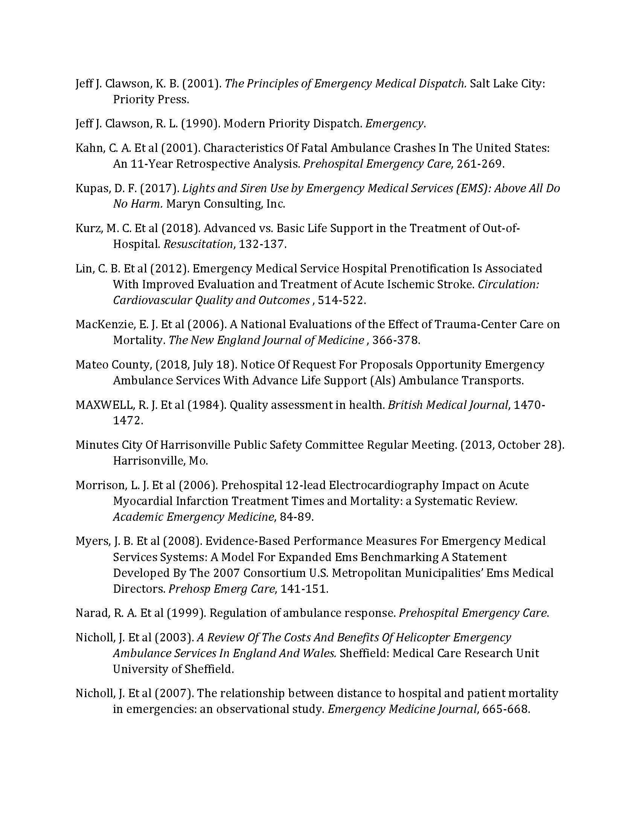
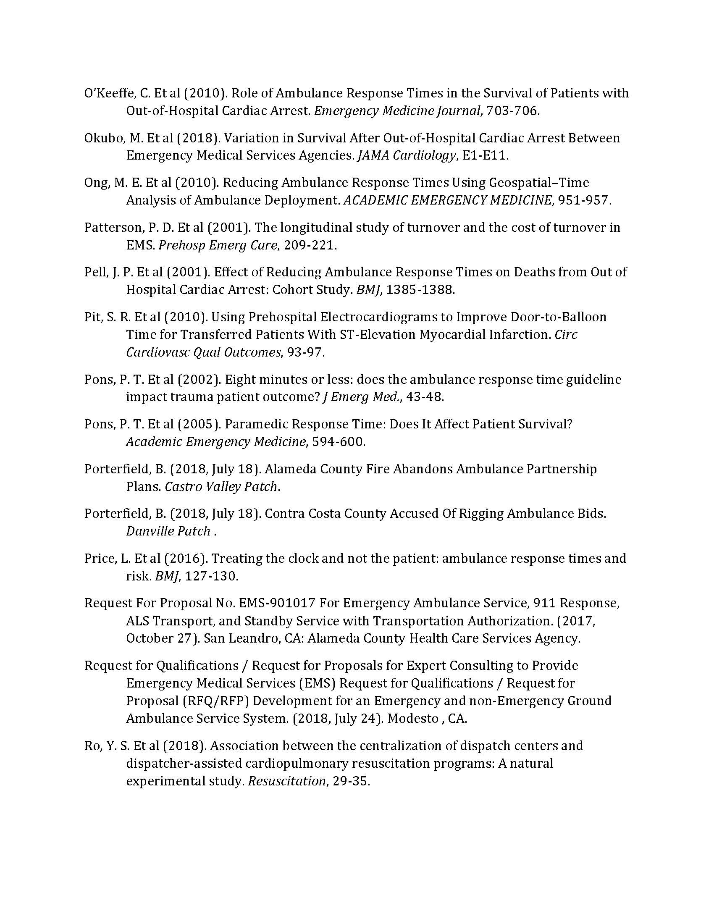
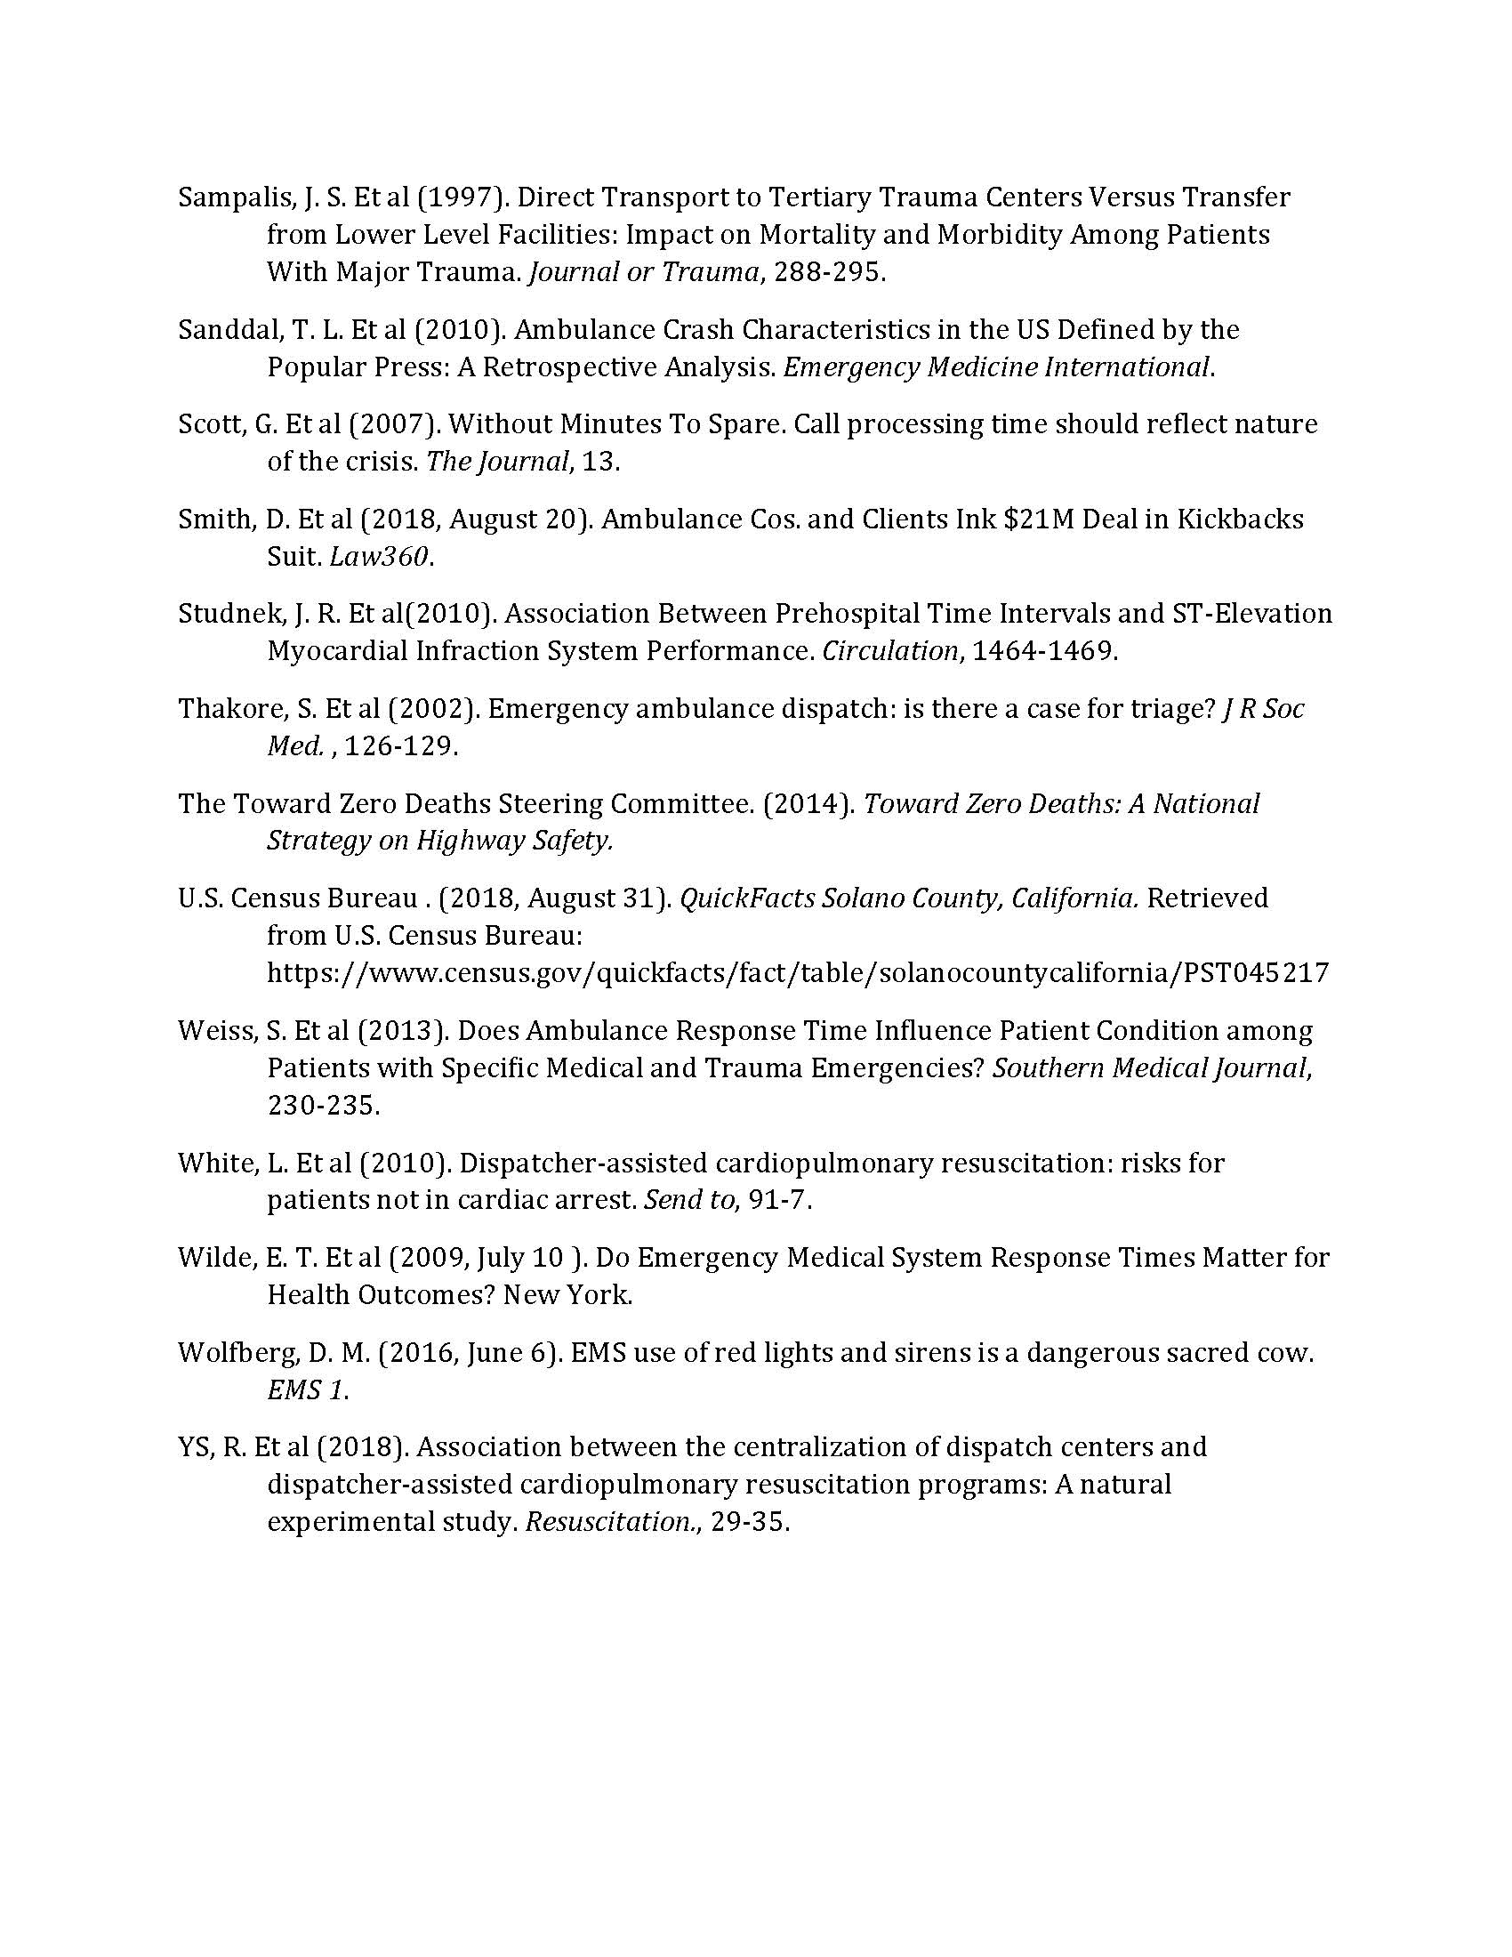

Slide 7
EMS System Review
High-functioning system
Exceptional compliance with performance standards
Effective public-private collaboration
Quality and innovation in clinical care
Robust and facilitative EMS Agency oversight
History of financial sustainability
Leveraging of specialty care resources

Slide 8
EMS System Review
The fact that the Solano County EMS System is high-functioning is what allows us to make “next level” recommendations
Do not construe the presence of recommendations as a rejection of all the things that are good in Solano County

Slide 9
To put it another way: We can’t plan for excellence in 2020-2030 if all we do is talk about how excellent we all were from 2010 - 2018

Slide 10
Why Change is Vital
The 2020-30 landscape is markedly different than the last procurement cycle
ACA and instability in insurance markets
Increase in self-pay through high-deductible plans
Shifts from FFS to pay-for-performance and value-based reimbursement
Evidence-based medicine – paying only for what works

Slide 11
The Two Guiding Principles
Incorporating evidence-based, clinical best practices to optimize outcomes
Maintaining and ensuring ongoing EMS system sustainability during the contract term

Slide 12
Revenues, Costs and Oversight
An EMS System can only do what its revenues permit it to do
This is really a process of optimizing a system along a continuum

Slide 13
Example
A system with a mobile intensive care unit with a physician, critical care nurse and paramedic for every square mile is desirable but unaffordable
A system with one BLS ambulance for every 100,000 people is affordable but undesirable
The ideal system configuration is somewhere along this continuum

Slide 14
Revenue Projections
Note that this analysis was done with no financial reporting or data from incumbent Contractor
Revenue projections are called projections for a reason

Slide 15
Revenues, Costs and Oversight
Any Local EMS Agency preparing for a new procurement cycle must be mindful of the Alameda and Santa Clara case studies
To prevent EMS System collapse, both Counties were compelled to pay subsidies to their contractors during the contract term in what were supposed to be zero-subsidy systems

Slide 16
Revenues, Costs and Oversight
Alameda - $4 million subsidy in 2015
Santa Clara - $7 million subsidy in 2016
As your consultants, we believe it is our professional obligation to present to you a sustainable EMS System configuration

Slide 17
Revenues, Costs and Oversight
What does sustainable mean?
Eliminating costly practices with no patient benefit
Ensuring that penalties are not incentivized into the system by the LEMSA coming to depend on them for its operating budget
Utilizing penalties only to reinforce and incentivize the avoidance of patient-critical “never events”

Slide 18
Revenues, Costs and Oversight
What does sustainable mean?
Minimizing the stakeholder “wish lists” of costly contractor obligations
Ensuring that LEMSA-imposed fees are reasonable and limited to its documented costs of oversight
Incorporating flexibility in light of changed circumstances that may affect both sides of the ledger – ten years is a long time in health care

Slide 19
Key Recommendations
Note: many additional issues will be proposed for inclusion in the RFP, but in the Blueprint report we are highlighting the major EMS system structural issues

Slide 20
Visual Diagrams of Current and Proposed System Configurations

Slide 21
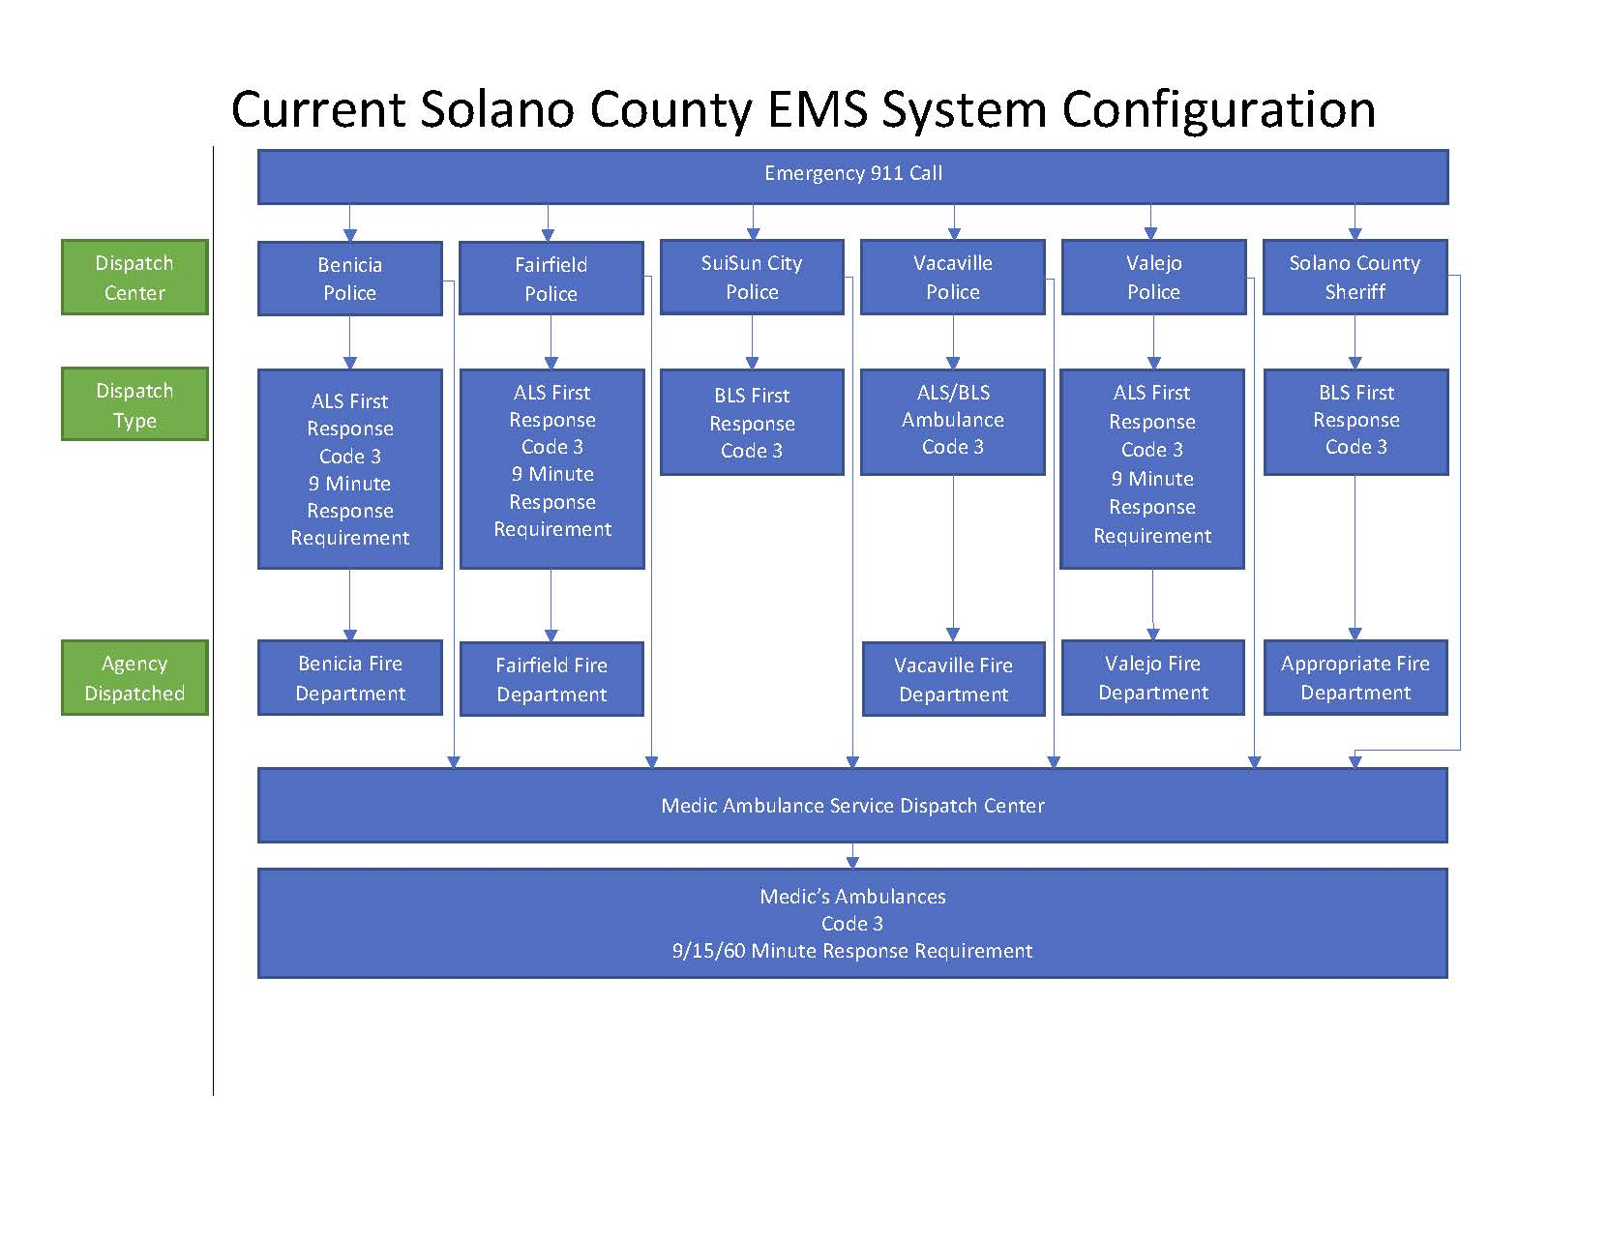

Slide 22
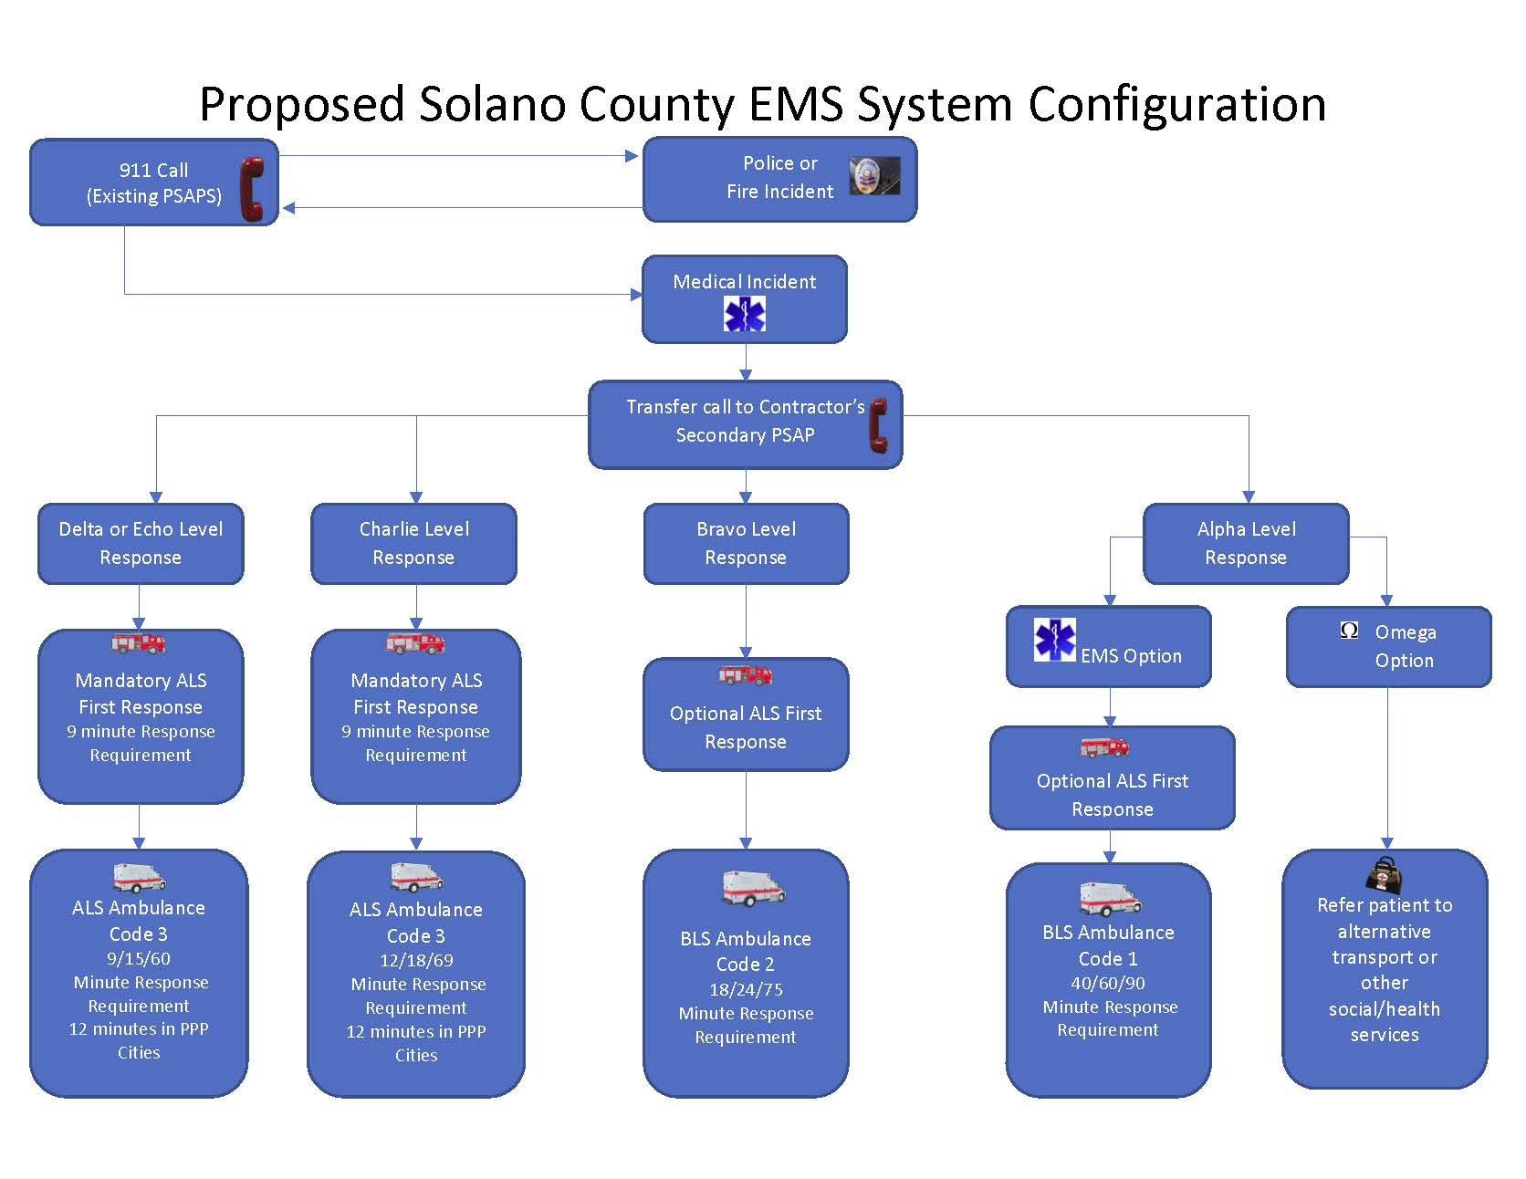

Slide 23
1. Implement Centralized EMD
Require Contractor to implement a secondary PSAP for transfer of all incoming 911 calls requiring EMS
Utilize NAED-compliant EMD protocols
Implement pre-arrival instructions
Use call processing time standards
Utilize EMD response determinants
Optional Emergency Communication Nurse Specialist (ECNS)

Slide 24
Note: many of the major recommendations for EMS system configuration in the 2020-2030 procurement cycle are dependent upon EMD implementation.

Slide 25
2. Implement Tiered EMS Response
With EMD implementation, differential response can be achieved
Charlie/Delta/Echo-level calls
ALS Amb + ALS FR
Alpha/Bravo-level calls
BLS or ALS Amb + ALS FR “Response Optional”
“Omega Protocol” option
For low-acuity or non-medical calls

Slide 26
3. Reduce Red Lights and Siren Use
Substantial data make it clear that RLS use is a hazard to crew, patients and the public
National benhmarks
<50% RLS for response
<5% RLS for transport
Limit Code 3 responses to Delta and Echo-level calls

Slide 27
4. Reconfigure Response Times
Data clearly show that response times do not affect positive outcomes for the overwhelming majority of EMS calls
Yet, response times are the single most expensive component of an EMS system
With EMD implementation, there is little reason to run Code 3 “as fast as possible” on a large subset of calls

Slide 28
Recommended 911 Response Times

Slide 29
5. Maintain, Modify and Expand PPP
Maintain the unit-hour savings formula for ALS-level calls (Charlie, Delta, Echo)
Modify Alpha-Bravo level calls to “ALS FR optional”
Expand the PPP agreement to include per-call compensation for use of PPP medics during transport and for certain on-scene services
Implement automatic increase = to Contractor CPI

Slide 30
6. Interfacility Transports
Incorporate CCTs into the EOA
Permit Contractor to subcontract if desired
Maintain options and standards from Resolution 12-001
We believe that including CCT in the EOA is critical
The implementation of ALS+RN led to the (proper) reclassification of calls as ALS vs. CCT
This led to a correction of CCT volume to expected statistical norms (from 4,000 calls to 400 calls/yr)

Slide 31
6. Interfacility Transports
As a result, some permitted CCT providers have stopped providing these services altogether in Solano County
Including CCTs in the EOA is the only reliable way to ensure that these critical services will be available, accountable and responsive

Slide 32
6. Interfacility Transports
Implement a retriage transport (RTT) program
This would allow for rapid interfacility transport of patients brought into an ED who are identified as requiring rapid transfer to another facility
We recommend that Contractor (or a subcontractor) be given a 15-minute right of first refusal
If Contractor/subcontractor not available within 15 minutes, ED can utilize the incoming ambulance for the RTT

Slide 33
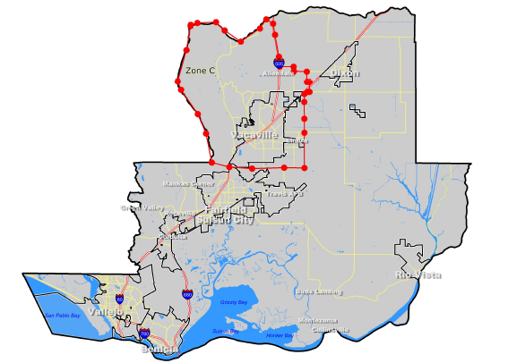
7. Include Zone C in EOA
Including Zone C in the RFP and EOA contract will allow for greater accountability and oversight of services in this part of the County

Slide 34
8. Restructure Fees & Liquidated Damages
Increase annual franchise fee to $600,000
Ensure that the system design incentivizes the right things
Clinical quality and outcomes vs. speed
De-emphasize response time penalties and focus on aligning incentives with quality care
Do not permit penalties to become a necessary revenue stream to fund LEMSA activities

Slide 35
Examples
STEMI Patients
Time to 12-lead for CP patients
Recognition of ST elevation
Time to STEMI alert
Transport to STEMI center
Stroke Patients
Documentation of prehospital stroke score
Time to stroke alert
Transport to stroke center

Slide 36
9. Patient Charges
Implement a scored, relative weighted formula in the RFP process for evaluating patient charges for service
Require the adoption of consumer protections such as hardship eligibility criteria and collections safeguards
Permit automatic annual increases up to Medical CPI

Slide 37
10. Workforce Provisions
Preferential hiring to incumbent EMTs/medics if change in Contractor
Implement turnover disincentives compared to national benchmarks
Require the promotion of diversity in the workforce
Assure training on infrequently-used skills (data driven)

Slide 38
11. Financial Reporting
Increase financial transparency with regular financial reporting of specified metrics
Require annual revenue cycle audits (billing, coding)
Require submission of annual financials

Slide 39
12. Contract Modification Option
Recommend including provisions expressly allowing for modifications for changed circumstances
Alameda, Santa Clara case studies

Slide 40
13. Experience Requirement
Require Contractor to possess current + 5 years’ experience serving an EOA population of at least 300,000

Slide 41
Summary and Conclusion

